Slide 1
Final Engagement
Attack, Defense & Analysis of a Vulnerable Network
Presented by Chase Carroll, Dylan Nelson, Lucas Martynec, Matt Gaulke
Mehrdad Bashiri, and Steven Bauer

Slide 2
Table of Contents
This document contains the following resources:
Red & Blue Team
Network Topology & Critical Vulnerabilities
Traffic Profile
Normal Activity
Malicious Activity

Slide 3
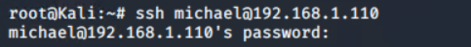
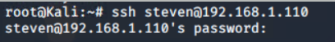
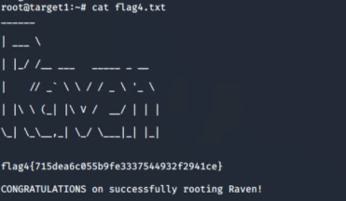
Red Team
Summary of Offensive Operations
-Scanning the network with Nmap reveals open ports and OS details.
-WPScan to enumerate users of the Target 1 Wordpress site.
-Cracking the password of the user Michael to SSH into the system.
-Using SQL to navigate the database and retrieve hashes of additional users.
-Cracking password hashes with “John the Ripper”.
-Using the next set of credentials to SSH into the system as user Steven.
-Checking Steven’s user privileges and escalating to root using a Python script.

Slide 4

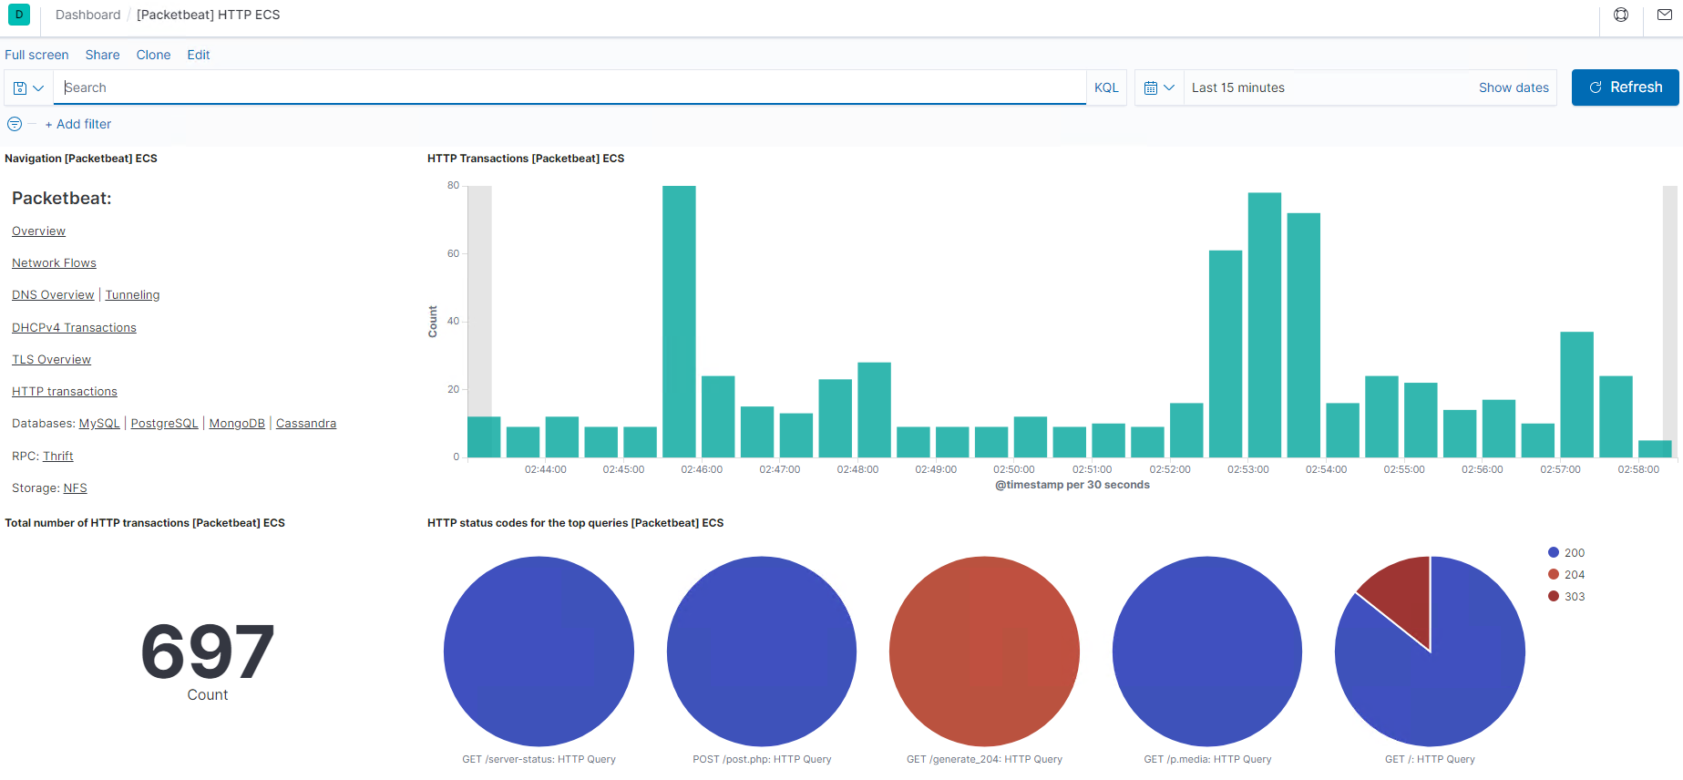

Blue Team
Summary of Defensive Operations
Prior to beginning our engagement, we Licensed our Elastic Stack - ELK Linux server with Beats (If you have an active license, do not revert to basic)
We Configured three main threshold alerts using the Elesticsearch Watcher functionality.
CPU Usage Monitor - HTTP Request Size Monitor -Excessive HTTP Error Monitor
- Three main mitigation focuses: Configuration changes, OS and Application Updates, Monitoring changes
- Patching of outdated Linux Versions and Wordpress installation
- Configuration changes including Account lockout policies for each application as well as complex password requirements. (ex. “# steven ALL=(ALL)NOPASSWD: /usr/bin/python” in Target1 sudoers file.)
- Instituting a continual improvement plan to evaluate and change alert thresholds
These strategies will help keep X-CORP off the cover of USA Today in the future!

Slide 5
Network Topology
& Critical Vulnerabilities
‹#›

Slide 6
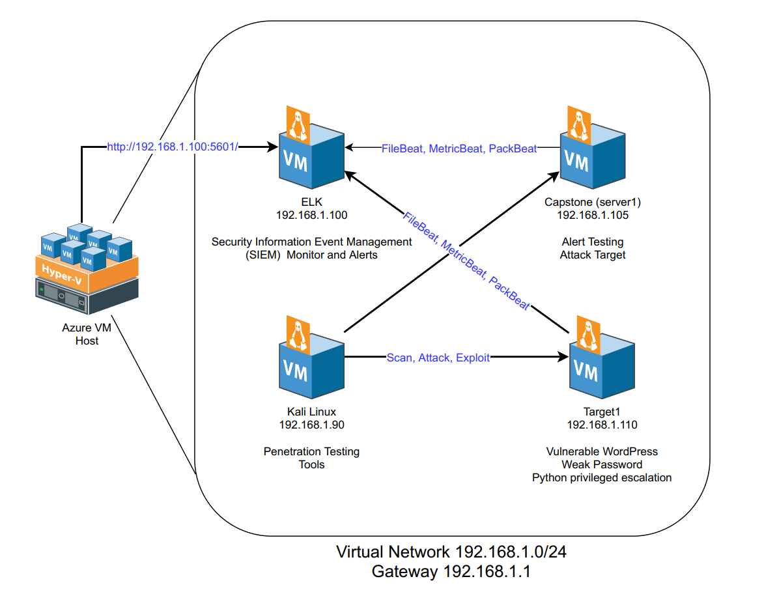
Network Topology
Network
Address Range: 192.168.1.0/24
Netmask: 255.255.255.0
Gateway: 192.168.1.1
Machines
IPv4: 192.168.1.90
OS: Kali Linux
Hostname: Kali
IPv4: 192.168.1.100
OS: Ubuntu Linux
Hostname: ELK
IPv4: 192.168.1.105
OS: Ubuntu Linux
Hostname: Server1 (Capstone)
IPv4: 192.168.1.110
OS: Debian Linux
Hostname: Target1

Slide 7
Critical Vulnerabilities: Target 1
Our assessment uncovered the following critical vulnerabilities in Target 1.
Vulnerability | Description | Impact
Wordpress user enumeration | WP scan returned sensitive information | Easily located usernames
Weak password requirements | Users with same user/password | Easily guessed/cracked passwords
Unsalted password hashes | Minimal encryption makes for easily cracked passwords | Access to user privileges
Python privilege escalation | Steven had the ability to invoke Python commands with sudo privileges | Allowed root level access through Python script

Slide 8
Traffic Profile
‹#›

Slide 9
Traffic Profile
Our analysis identified the following characteristics of the traffic on the network:
Feature | Value | Description
Top Talkers (IP Addresses) | 172.16.4.205 (51,364 packets) 185.243.115.84 (30,344 packets) 10.0.0.201 (19,503 packets) | Top three devices which generated the most network traffic (packets).
Most Common Protocols | Internet Protocol Version 4 (IPv4) TCP (88.5%) UDP (11.2%) | Protocols are a set of rules regarding how the network operates. TCP is a connection-oriented protocol, whereas UDP is a connectionless protocol.
# of Unique IP Addresses | 808 | Unique IPv4 IP addresses and 30 MAC address captured.
Subnets | 10.0.0.0/24, 10.6.12.0/24, 10.11.11.0/24,172.16.4.0/24, 192.168.1.0/24 | Observed subnet ranges.
Malware Species | Trojan - june11.dll Fake Browser Update Pop-Up Remote Access Trojan (RAT) | Malware binaries identified in traffic.
Notes:
You may have more than 2 subnets.

Slide 10

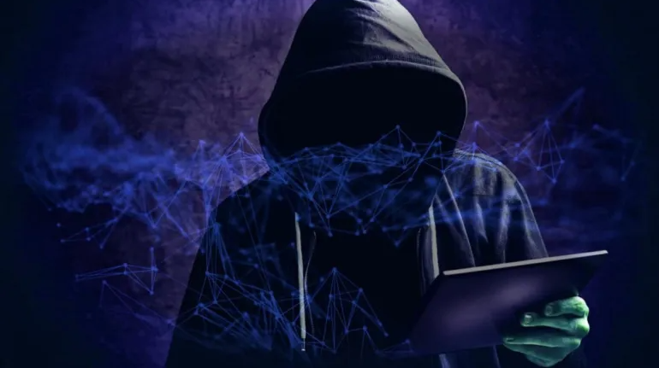
Behavioral Analysis
Purpose of Traffic on the Network
Users were observed engaging in the following kinds of activity.
“Normal” Activity
Online shopping After Hours
Web Browsing Hospital Information
WordPress Blog Browsing
Suspicious Activity
Web browsing for iPhone hacks and Jailbreaking.
Torrent traffic used to download a movie typically against
company policies.
Trojan Malware Downloaded
Fake Browser Update Pop-Up (RAT)

Slide 11
Normal Activity
‹#›

Slide 12
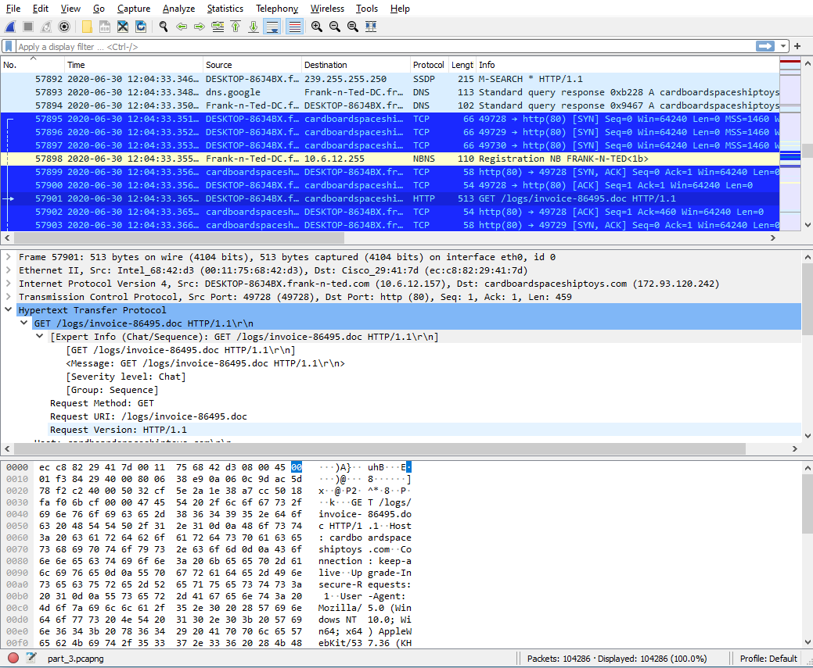
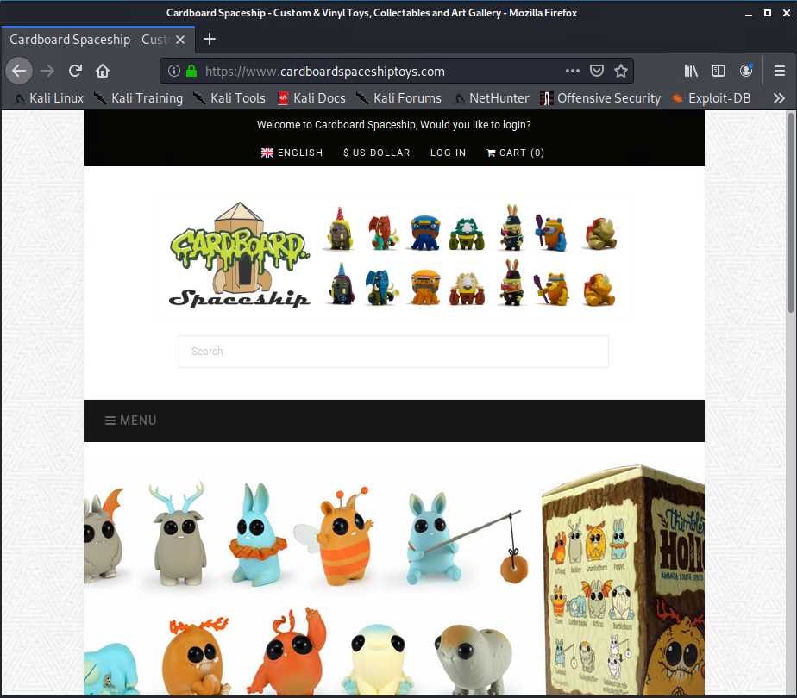
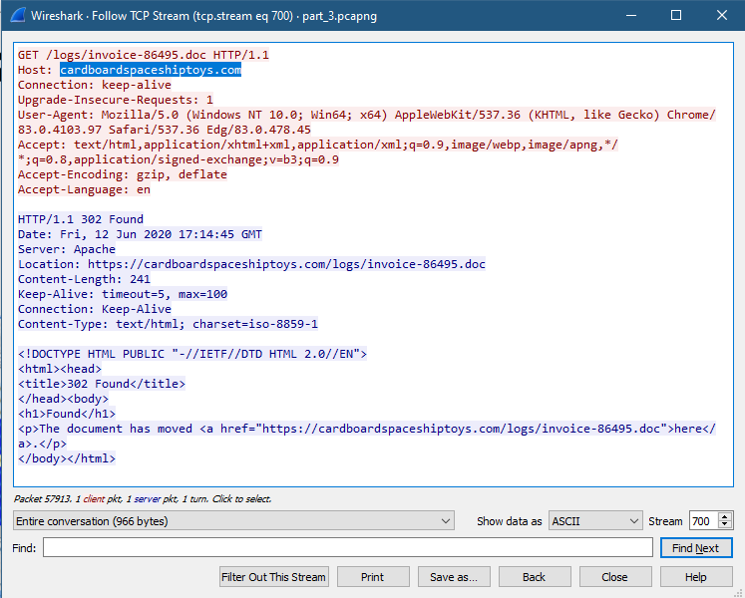
Online Shopping After Hours
HTTP web browsing traffic from 10.6.12.157 to 172.91.120.242 http://www.cardboardspaceshiptoys.com
The user (ted.brokowski) browsing from DESKTOP-86J4BX.frank-n-ted.com was toy shopping and made a purchase at the website as an invoice file was captured.
There is TLS1.3 protocol application data, which enrypts the TCP protocol session of HTTPS traffic from port 443 to port 49731

Slide 13
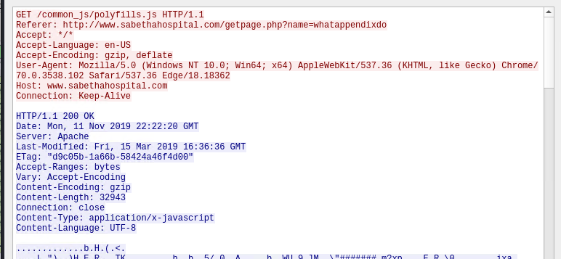
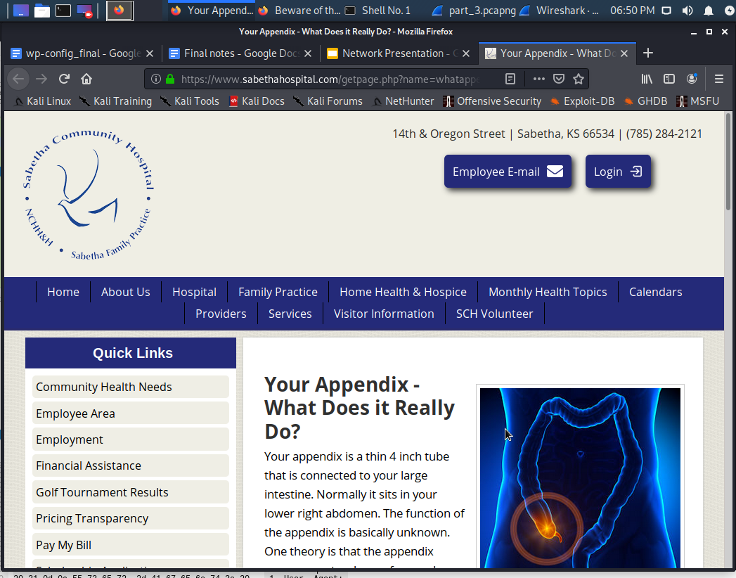
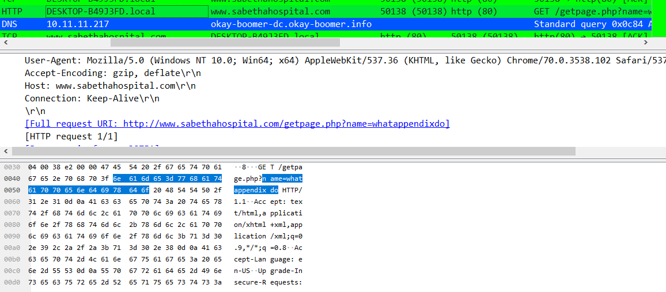

Web Browsing Hospital Information
User of DESKTOP-B49J3FD.local (10.11.11.195) was
browsing the www.sabethahospital.com (12.133.50.21) webpage,
specifically researching the function of the appendix organ.
There are several different pages that were loaded, several java
and php content files, the appendix info was most interesting.
All of the traffic was TCP protocol, HTTP traffic from Port 80
10.11.11.195:50137-50150 <> 12.133.50.21:80

Slide 14

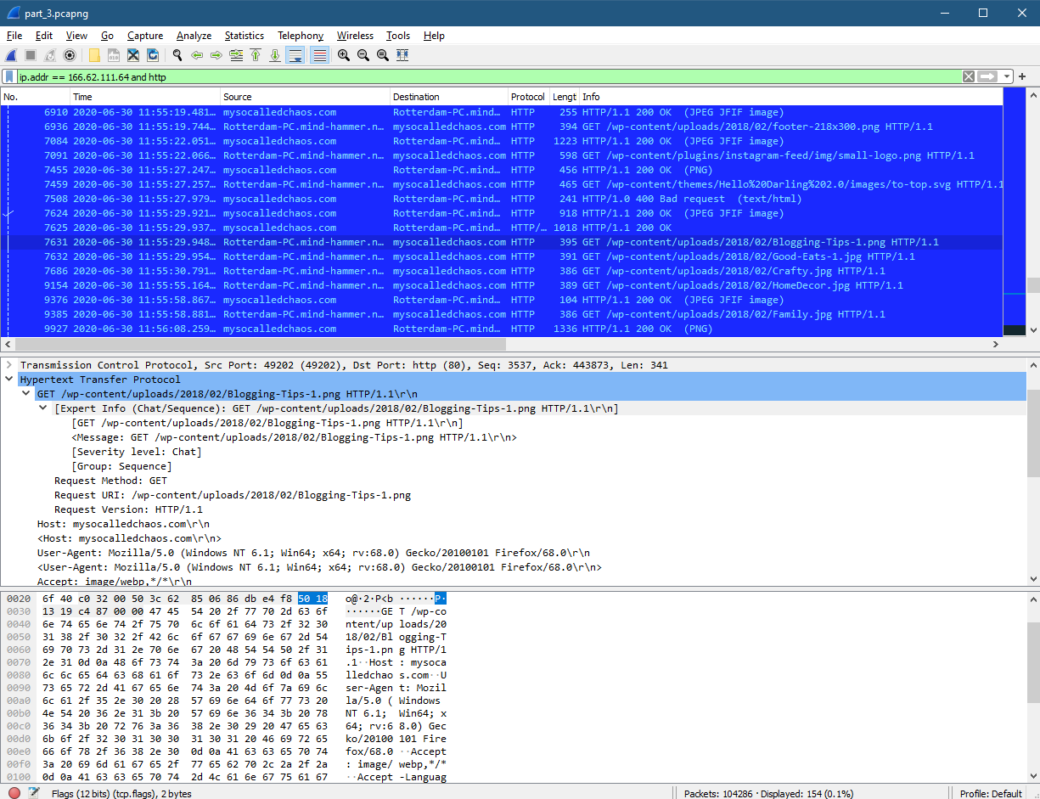
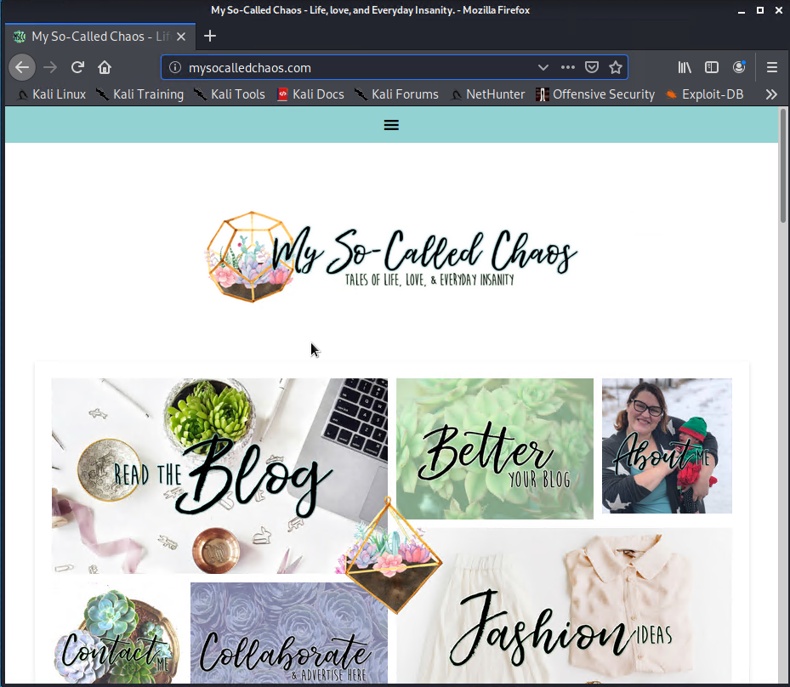
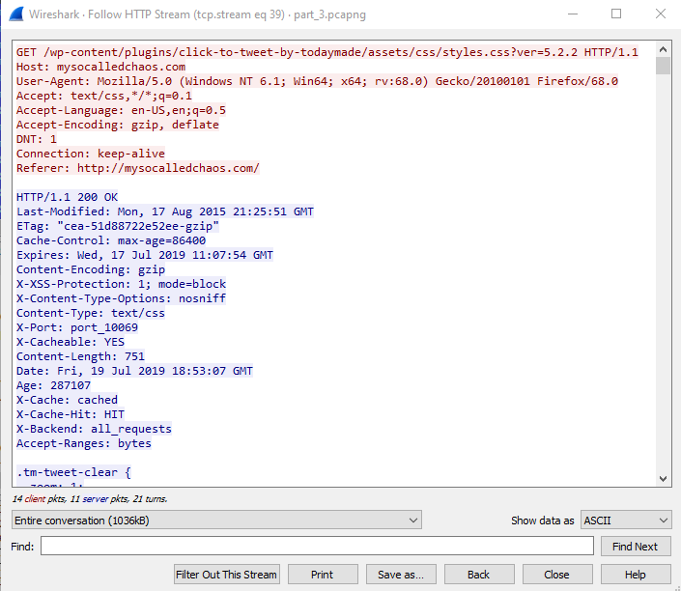
WordPress Blog Browsing
The user (matthijs.devries) Rotterdam-PC.mind-hammer.net host was browsing Angie’s WordPress Blog.
HTTP WordPress traffic from 172.16.4.205 to 166.62.111.64 http://mysocalledchaos.com/
Unencrypted TCP protocol traffic from port 80 - port 49190

Slide 15
Malicious Activity
‹#›

Slide 16

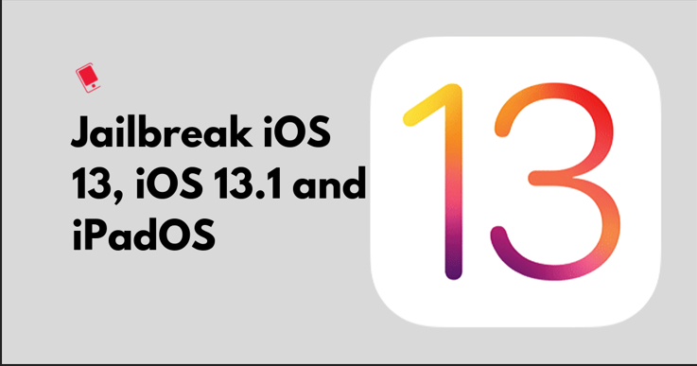
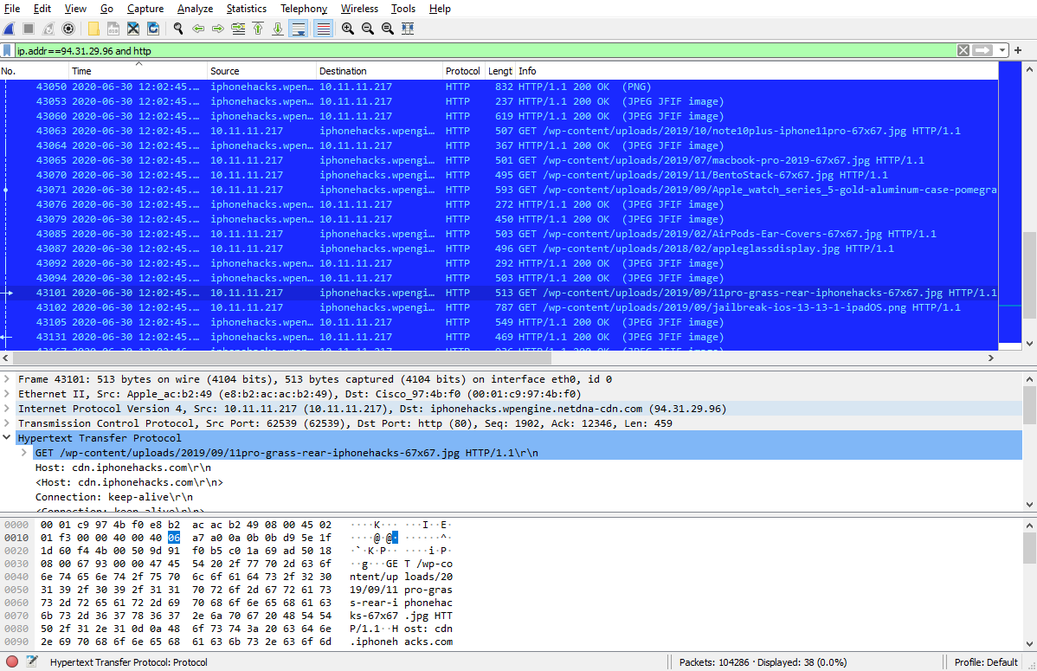
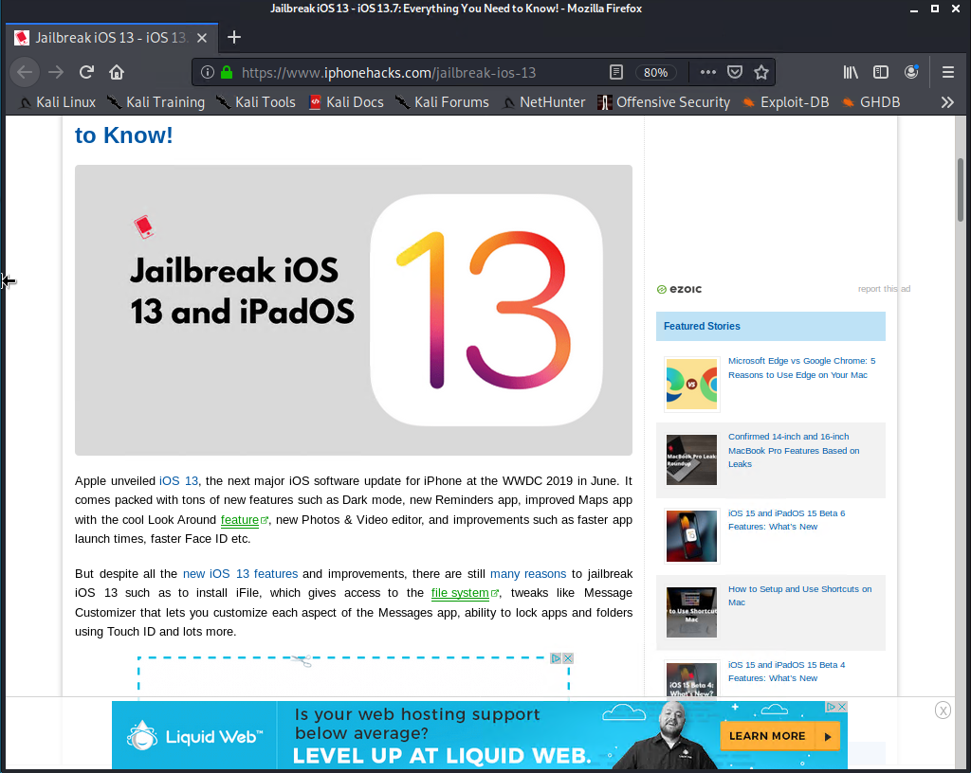
Instructions to Jailbreak iOS Devices
Summarize the following:
HTTP traffic to iPhone Hacks website at 94.31.29.96
The user was researching how to Jailbreak iPhone iOS 13.

Slide 17

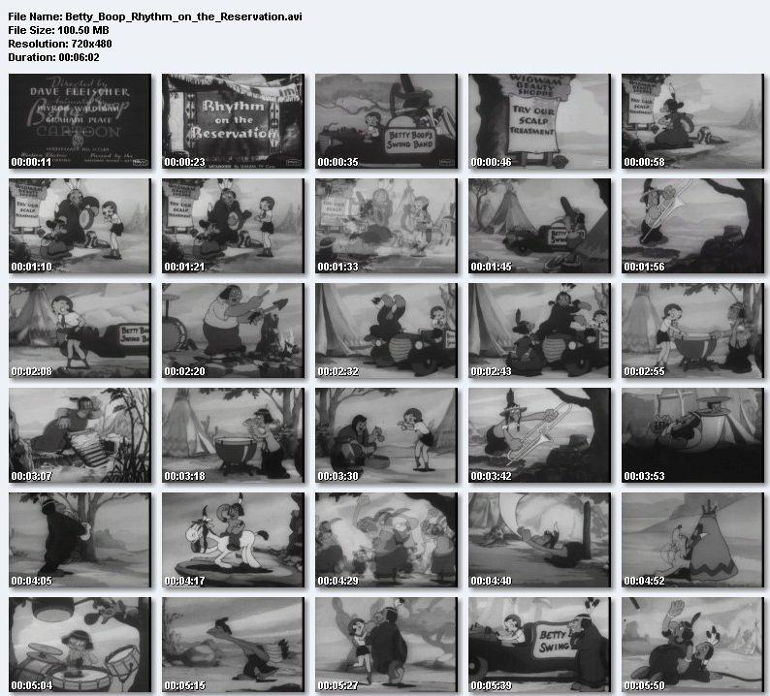
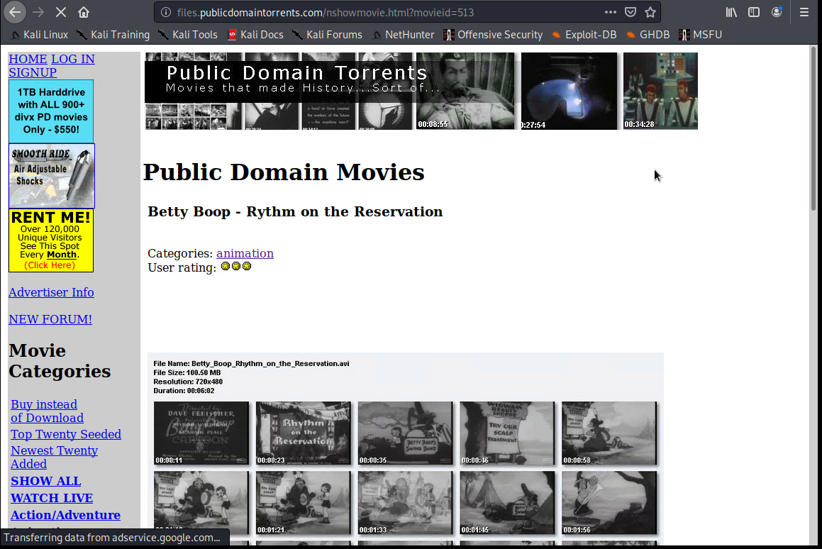
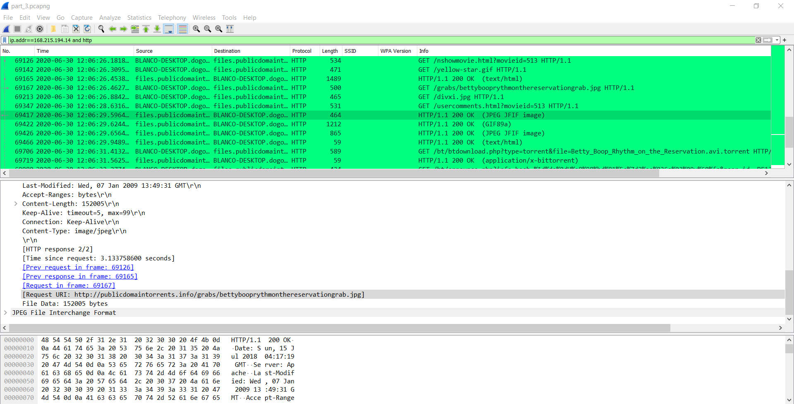
Torrents of Material Against Policy
Summarize the following:
HTTP traffic from 168.215.194.14 (files.publicdomaintorrents.com) to 10.0.0.24
The user was downloading torrents going against policy, specifically a movie called “Betty_Boop_rythym_on_the_reservation”

Slide 18
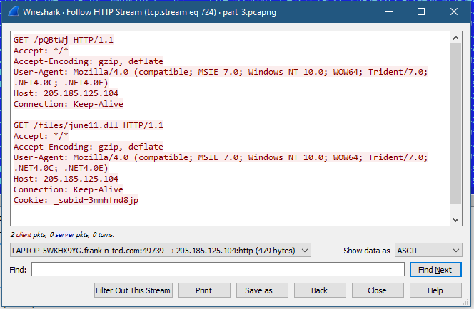
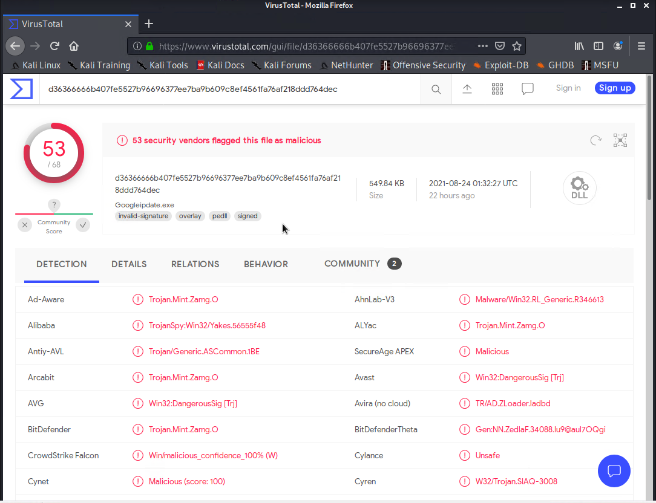
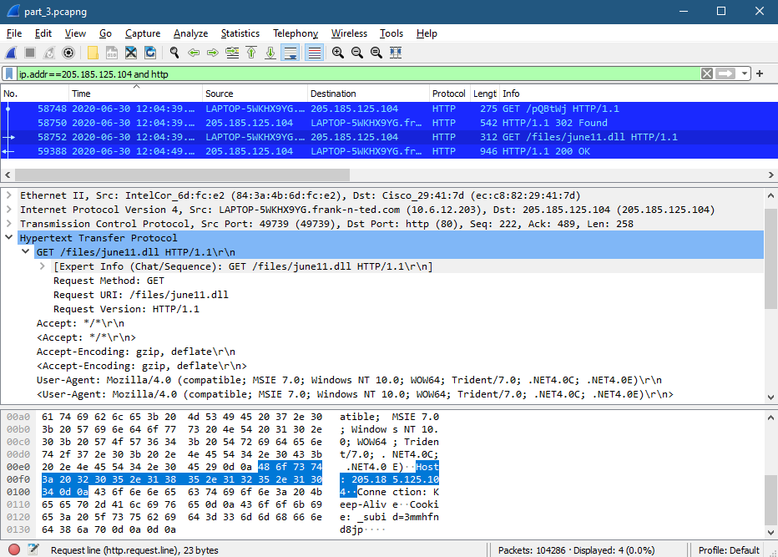
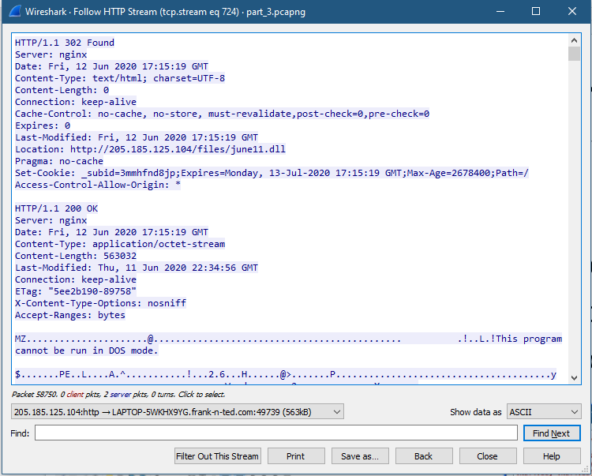
Trojan Malware Downloaded
Summarize the following:
Initial HTTP traffic from the user’s computer 10.6.12.203 to IP Address 205.185.125.104.
Trojan Malware “june11.dll” was downloaded and the computer became infected.

Slide 19
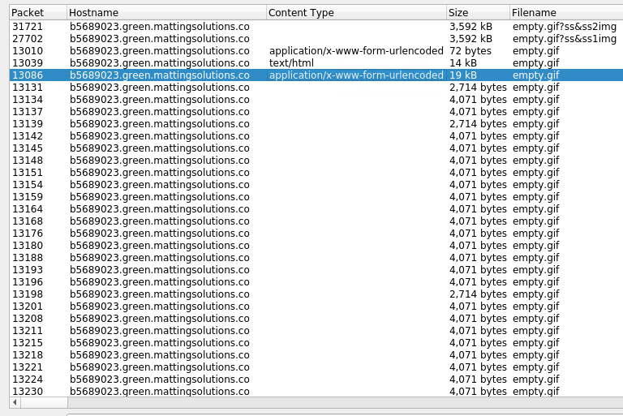
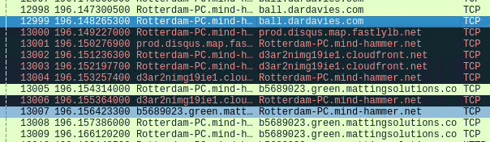
Fake Browser Update Pop-Up (RAT)
The Rotterdam-PC.mindhammer.net was browsing on
ball.dardavies.com and clicked a link which spurred a
TCP stream to b5689023.green.mattingsolutions.co
which is a known compromised URL which downloads
empty.gif files which create a backdoor into the infected
machine and links the machine to a command
and control server.

Slide 20
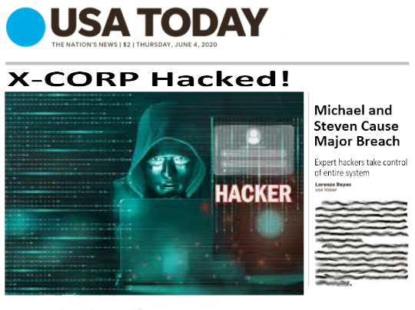
Always remember: “You do NOT want your company to end up on the front page of USA TODAY.”

Slide 21
The End
Chase Carroll
Dylan Nelson
Lucas Martynec
Matt Gaulke
Mehrdad Bashiri
Steven Bauer
Thank you!
“Don’t cry because it’s over.
Smile because it happened.”
-Dr. Seuss
‹#›

